Slide 1


FINANCIAL PERFORMANCE ANALYSIS OF AMAZON.COM INC. (2021–2024)
Global Logistics Management
Name: Sowmiya Jayaseelan
Domain: Supply Chain & Logistics Management

Slide 2
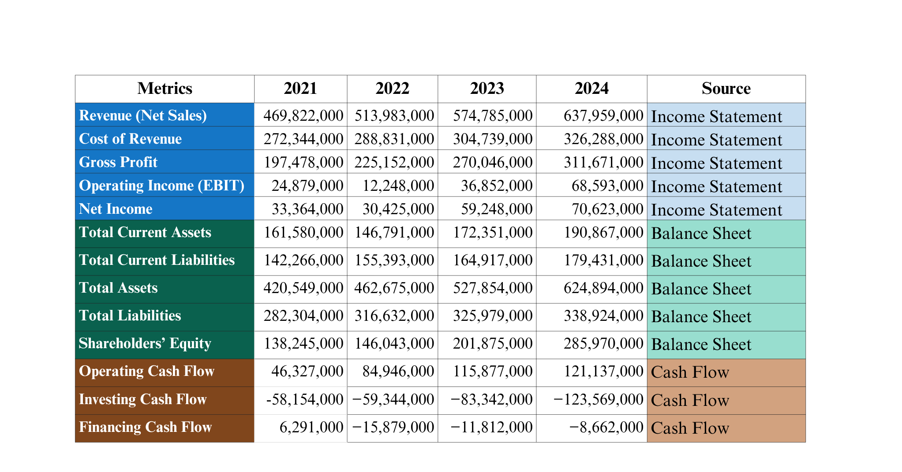
Financial Performance
1
2
3
4
5
6
Source: Yahoo Finance (2021–2024); Amazon.com Annual Report, 2024

Slide 3
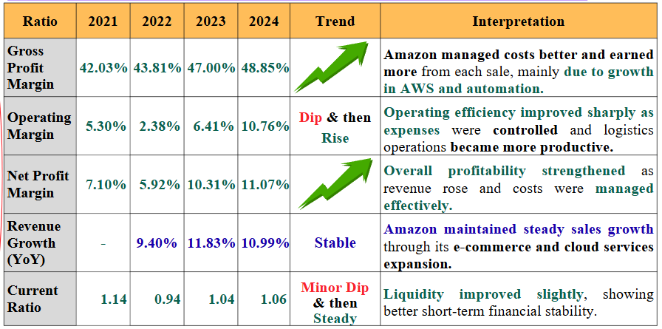
Financial Ratio Trends
Data compiled from Yahoo Finance (2021–2024).
1
2
2
3
4
5
6
Source: Yahoo Finance, MacroTrends (2022–2024).

Slide 4
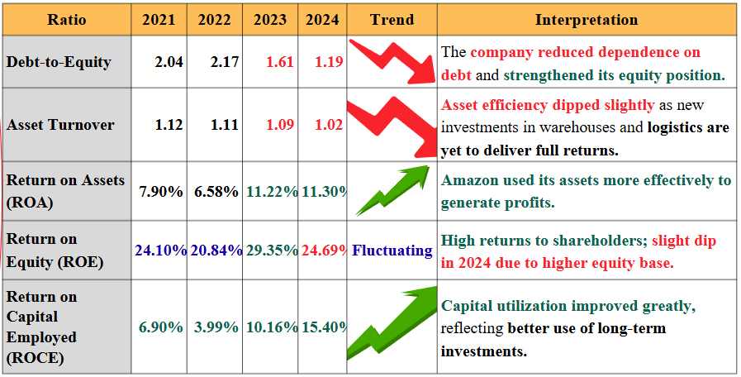
Financial Ratio Trends
Data compiled from Yahoo Finance (2021–2024).
1
2
3
4
5
6

Slide 5



Evaluation of Amazon’s Financial Accounts
Profitability & Growth
Liquidity & Solvency
Efficiency & Returns
Margins improved at every level gross 42.3% → 48.9 %, operating 5.3 % → 10.8 %, net 7.1 % → 11.1 %.
Growth driven by AWS and automation within logistics operations.
Revenue rose steadily (~11 % YoY) showing consistent expansion.
Current ratio 1.14 → 1.06 better ability to meet short-term obligations.
Debt-to-equity 2.04→ 1.19 lower financial risk and stronger equity base.
Balanced capital structure with reduced reliance on external borrowing.
ROCE 6.9 % → 15.4 % major improvement in capital utilization.
ROA 7.9 % → 11.3 %, ROE ≈ 25 % high shareholder value creation.
Slight fall in asset turnover (1.12 → 1.02) due to new long-term investments in logistics assets.
1
2
3
4
5
Amazon’s 2022 dip was a natural correction following the post-pandemic sales surge. Since then, the company has recovered strongly, improving its profitability and operational efficiency year over year
Financial accounts reflect strong recovery, better cost control, and long-term sustainability.
Continuous investment in technology and automation is translating into higher profitability and capital efficiency.
6
Analysis based on Amazon financial statements (2021–2024).

Slide 6
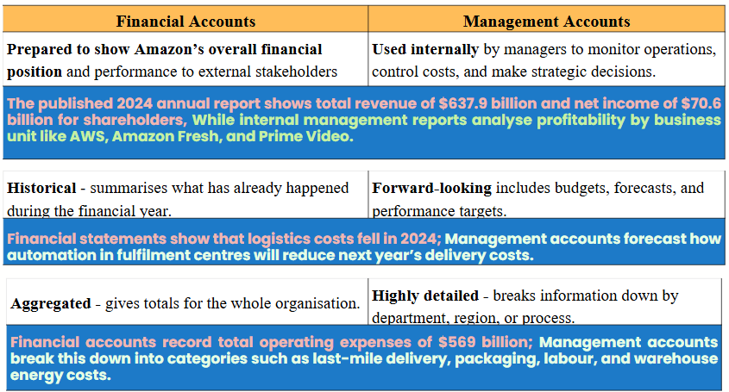
Financial vs. Management Accounts
Purpose
1
2
3
4
Nature of Information
5
6
Level of Detail
Source: Amazon 2024 Annual Report; Investopedia (2023).

Slide 7
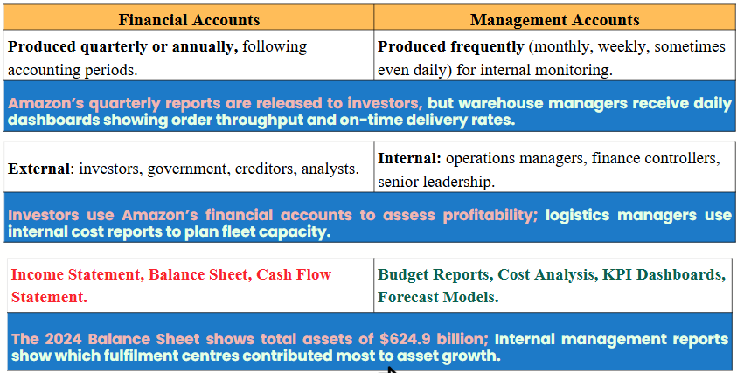

Financial vs. Management Accounts
Frequency
1
2
3
4
Users
5
6
Output
Both essential for Amazon's strategic decisions and accountability

Slide 8
Re
Sources of Finance
How this used to improve the transport operator’s financial performance ?
Public/Government Sources
Internal Source
External Source
Retained Earnings
Trade Credit
Equity Financing (Share Issue)
Long-Term Debt / Bonds
Leasing / Hire Purchase
Green Finance / ESG Bonds
UK TRIG
MSRS & WFG Grants
British Business Bank Programmes
1
2
Reinvestment into automation, AI-based logistics systems, and short-term working capital management.
Funding innovation in logistics, automation, sustainability, and infrastructure in the UK.
3
Used for large-scale expansion projects such as warehouse construction, electric vehicle fleets, robotics, and digital platforms.
4
Used
5
6
Enhances operational efficiency, funds innovation at no cost, improves liquidity and cash flow.
Supports long-term growth and asset development, improves productivity, and strengthens Amazon’s environmental reputation.
Encourages R&D, reduces carbon emissions, boosts competitiveness, and strengthens sustainable logistics operations.
Impact
Combined Impact: Financial Stability + Operational Efficiency + Sustainable Growth
Sources: UK Department for Transport (TRIG, MSRS, 2024); British Business Bank Programmes; Amazon Annual Report, 2024.

Slide 9
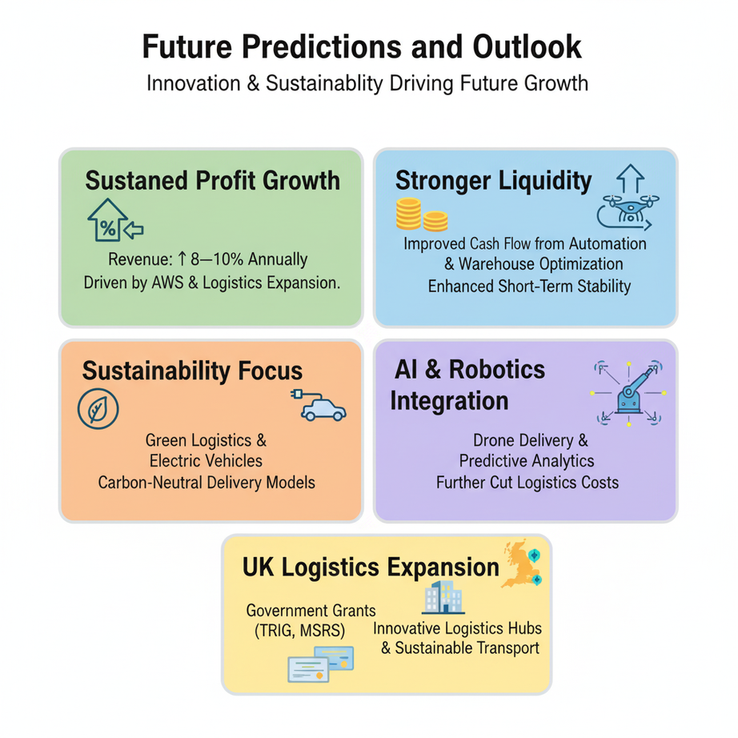
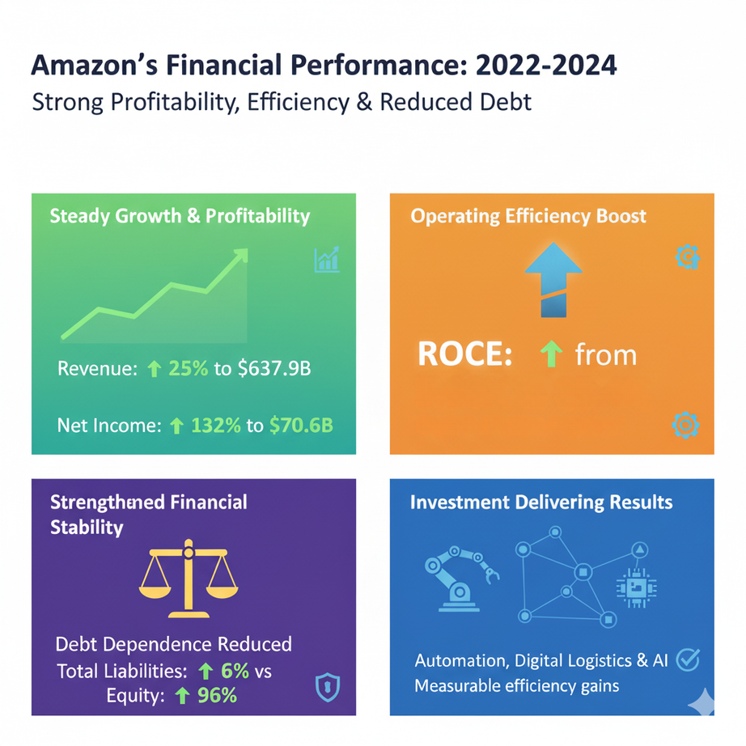
Re
Conclusion & Future Outlook
By comparing 2021 through 2024, Amazon’s performance reflects resilience - recovering from a short-term margin contraction in 2022 to achieve its highest operational and return ratios by 2024
Amazon’s Financial Performance 2021-2024
1
2
3
4
8.9% to 15.4%
Capital utilzation improved
5
6
Amazon’s Future: Efficient · Sustainable · Profitable
Predictions supported by Amazon Sustainability Report (2024); MacroTrends (2025) data.

Slide 10
Declaration & Acknowledgement
This presentation was prepared using data from Yahoo Finance (2021–2024).
AI tools were used for structural guidance and to prepare visual images only.
All analysis, interpretation, and evaluation were performed by me (Ms. Sowmiya)
I express my sincere gratitude to Yahoo Finance for providing reliable financial data used in this analysis, and to Amazon.com Inc. for making publicly available reports that offered valuable insights into real-world business performance.
I also wish to acknowledge OpenAI and Google Gemini AI for assistance in structuring, and visually enhancing this presentation. Their tools supported for clarity and creativity.

Slide 11


REFERENCES
Amazon.com, Inc. (2025). 2024 Annual Report. Seattle, WA: Amazon.com, Inc. https://s2.q4cdn.com/299287126/files/doc_financials/2025/ar/Amazon-2024-Annual-Report.pdf Q4 Capital+1
Amazon.com, Inc. (2025). Annual Reports, Proxies & Shareholder Letters.
https://ir.aboutamazon.com/annual-reports-proxies-and-shareholder-letters/default.aspx ir.aboutamazon.com
MacroTrends. (2025). Amazon Financial Statements 2009-2025. https://www.macrotrends.net/stocks/charts/AMZN/amazon/financial-statements MacroTrends
Investopedia. (2023). How Amazon Makes Money. https://www.investopedia.com/how-amazon-makes-money-4587523
Department for Transport (DfT) & Connected Places Catapult. (2025). Transport Research and Innovation Grants (TRIG). https://cp.catapult.org.uk/transport-research-and-innovation-grants/ Connected Places Catapult+2Connected Places Catapult+2
Government of the United Kingdom. (2024). Transport Research Innovation Grants – Funding Winners.
https://www.gov.uk/government/publications/transport-technology-research-innovation-grants-t-trig-funding-winners
AnnualReports.com. (2025). Amazon.com Inc. – Most Recent Annual Reports. https://www.annualreports.com/Company/amazoncom-inc Annual Reports
Sustainability.aboutamazon.com. (2024). Amazon Sustainability Report 2024. https://sustainability.aboutamazon.com/2024-amazon-sustainability-report.pdf sustainability.aboutamazon.com

